Slide 1
Although the preterite and imperfect both express past actions or states, the two tenses have different uses. They are not interchangeable.

Slide 2
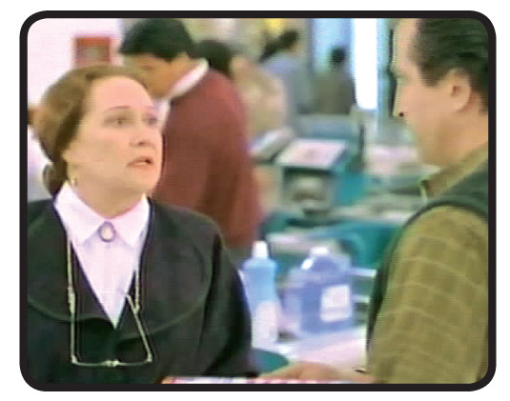
Uses of the preterite
To express actions or states viewed by the speaker as completed.
Viviste en ese barrio el año pasado.
You lived in that neighborhood last year.
Mis amigas fueron al centro comercial ayer.
My girlfriends went to the mall yesterday.
—Mi hijo murió en un choque.

Slide 3
To express the beginning or end of a past action.
La telenovela empezó a las ocho.
The soap opera began at eight o’clock.
Estas dos noticias se difundieron la semana pasada.
These two news items were broadcast last week.

Slide 4
To narrate a series of past actions.
Salí de casa, crucé la calle y entré en el edificio.
I left the house, crossed the street, and entered the building.
Llegó al centro, le dieron indicaciones y se fue.
He arrived at the center, they gave him directions, and he left.

Slide 5
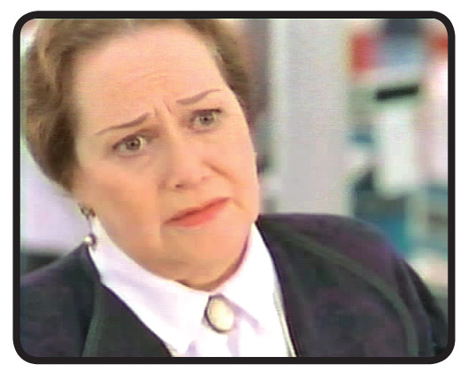
Uses of the imperfect
To describe an ongoing past action without reference to beginning or end.
No se podía parar delante de la comisaría.
Stopping in front of the police station was not permitted.
Juan tomaba el transporte público frecuentemente.
Juan frequently took public transportation.
—El otro conductor iba borracho.

Slide 6
To express habitual past actions.
Me gustaba jugar al fútbol los domingos.
I used to like to play soccer on Sundays.
Solían hacer las diligencias los fines de semana.
They used to run errands on weekends.

Slide 7
To describe mental, physical, and emotional states or conditions.
Estaba muy nerviosa antes de la entrevista.
She was very nervous before the interview.

Slide 8
To tell time.
Eran las ocho y media de la mañana.
It was eight thirty a.m.

Slide 9
The preterite and imperfect used together
When narrating in the past, the imperfect describes what was happening, while the preterite describes the action that interrupted the ongoing activity. The imperfect provides background information, while the preterite indicates specific events that advance the plot.
Here are some transitional words useful for clarity when narrating past events.
primero first entonces then
al principio in the beginning luego then, next
antes (de) before siempre always
después (de) after mientras while
al final finally la última vez the last time
¡ATENCIÓN!
Notes:
make both columns align left; leave generous gutter between columns

Slide 10
Mientras estudiaba, sonó la alarma contra incendios. Me levanté de un salto y miré el reloj. Eran las 11:30 de la noche. Salí corriendo de mi cuarto. En el pasillo había más estudiantes. La alarma seguía sonando. Bajamos las escaleras y, al llegar a la calle, me di cuenta de que hacía un poco de frío. No tenía un suéter. De repente, la alarma dejó de sonar. No había ningún incendio.
While I was studying, the fire alarm went off. I jumped up and looked at the clock. It was 11:30 p.m. I ran out of my room. In the hall there were more students. The alarm continued to blare. We rushed down the stairs and, when we got to the street, I realized that it was a little cold. I didn’t have a sweater. Suddenly, the alarm stopped. There was no fire.

Slide 11
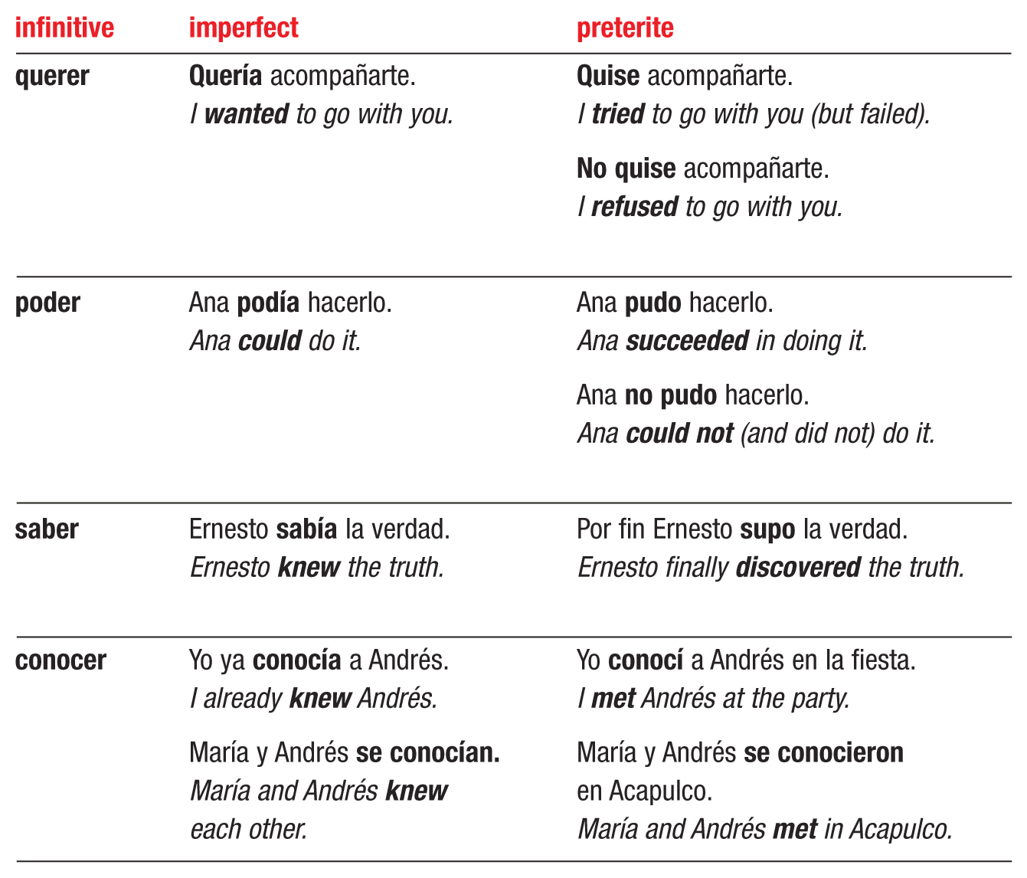
Different meanings in the imperfect and preterite
The verbs querer, poder, saber, and conocer have different meanings when they are used in the preterite. Notice also the meanings of no querer and no poder in the preterite.

Slide 12
Saber and conocer are not usually interchangeable. Saber means to know (facts, information, or how to do something), while conocer means to know or to be familiar/acquainted with (a person, place, or thing).
Some contexts, however, lend themselves to either verb.
La policía sabía/conocía el paradero del sospechoso.
The police knew of the suspect’s whereabouts.
¡ATENCIÓN!

