Slide 1
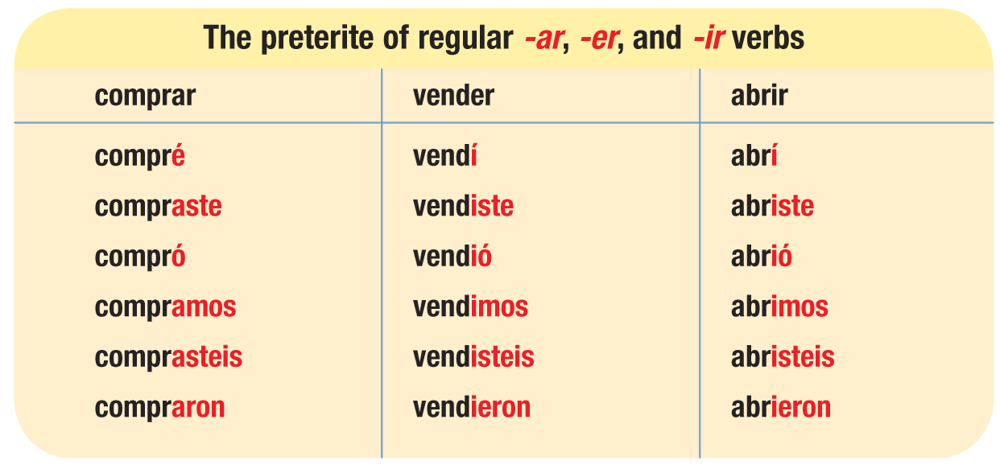
Spanish has two simple tenses to indicate actions in the past: the preterite (el pretérito) and the imperfect (el imperfecto). The preterite is used to describe actions or states that began or were completed at a definite time in the past.

Slide 2
The preterite tense of regular verbs is formed by dropping the infinitive ending (-ar, -er, -ir) and adding the preterite endings. Note that the endings of regular -er and -ir verbs are identical in the preterite tense.

Slide 3
The preterite of all regular and some irregular verbs requires a written accent on the preterite endings in the yo, usted, él, and ella forms.
Ayer empecé un nuevo trabajo. | Mi mamá preparó una cena deliciosa.
Yesterday I started a new job. | My mom prepared a delicious dinner.

Slide 4
Verbs that end in -car, -gar, and -zar have a spelling change in the yo form of the preterite. All other forms are regular.
buscar
llegar
empezar
busc-
lleg-
empez-
-qu-
-gu-
-c-
yo busqué
yo llegué
yo empecé

Slide 5
Caer, creer, leer, and oír change -i- to -y- in the usted, él, and ella forms and in the ustedes, ellos, and ellas forms of the preterite. They also require a written accent on the -i- in all other forms.
caer
creer
leer
oír
caí, caíste, cayó, caímos, caísteis, cayeron
creí, creíste, creyó, creímos, creísteis, creyeron
leí, leíste, leyó, leímos, leísteis, leyeron
oí, oíste, oyó, oímos, oísteis, oyeron

Slide 6
Verbs with infinitives ending in -uir change -i- to -y- in the usted, él, and ella forms and in the ustedes, ellos, and ellas forms of the preterite.
construir
incluir
construí, construiste, construyó, construimos, construisteis, construyeron
incluí, incluiste, incluyó, incluimos, incluisteis, incluyeron

Slide 7
Stem-changing -ir verbs also have a stem change in the usted, él, and ella forms and in the ustedes, ellos, and ellas forms of the preterite.
Other -ir stem-changing verbs include:
conseguir repetir
consentir seguir
hervir sentir
morir servir
preferir
¡ATENCIÓN!

Slide 8
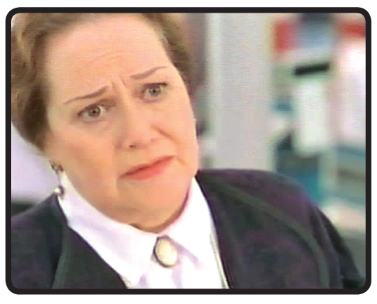
Stem-changing -ar and -er verbs do not have a stem change in the preterite.
A number of verbs, most of them -er and -ir verbs, have irregular preterite stems. Note that none of these verbs takes a written accent on the preterite endings.
—Nunca tuve oportunidad de despedirme de él.

Slide 9
Ser, ir, and dar also have irregular preterites. The preterite forms of ser and ir are identical. Note that the preterite forms of ver are regular. However, unlike other regular preterites, they do not take a written accent.
ser/ir
fui, fuiste, fue, fuimos, fuisteis, fueron
dar
di, diste, dio, dimos, disteis, dieron
ver
vi, viste, vio, vimos, visteis, vieron
The preterite of hay is hubo.
Hubo dos conciertos el viernes.
There were two concerts on Friday.
¡ATENCIÓN!

Slide 10
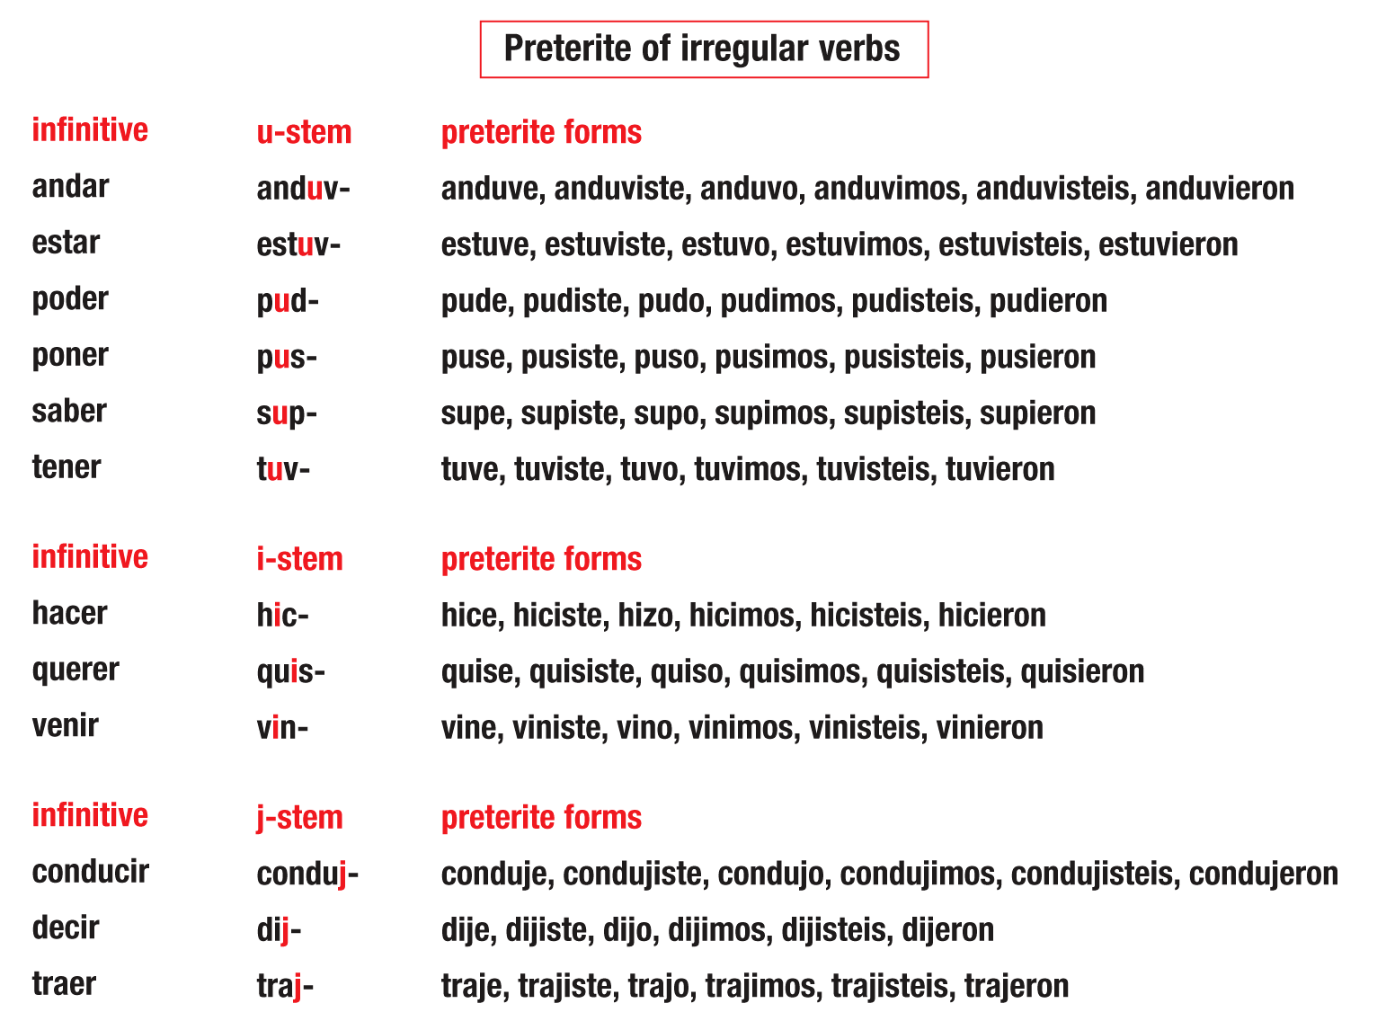
Note that the third-person plural ending of j-stem preterites drops the i: dijeron, trajeron.
¡ATENCIÓN!

Slide 11
Note that not only does the stem of decir (dij-) end in j, but the stem vowel e changes to i. In the usted, él, and ella form of hacer (hizo), c changes to z to maintain the pronunciation. Most verbs that end in -cir have j-stems in the preterite.

