Slide 1
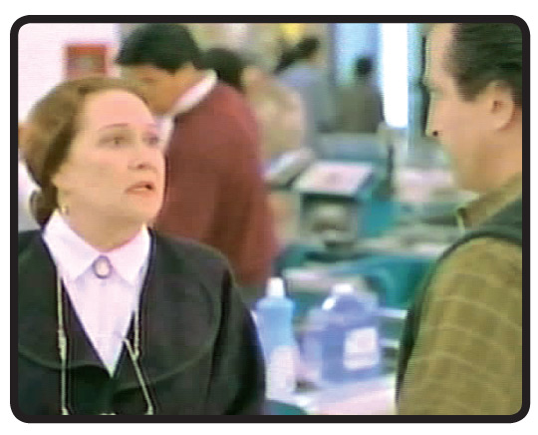
The imperfect tense in Spanish is used to narrate past events without focusing on their beginning, end, or completion.
—Mi hijo era tímido y de pocas palabras como usted.

Slide 2
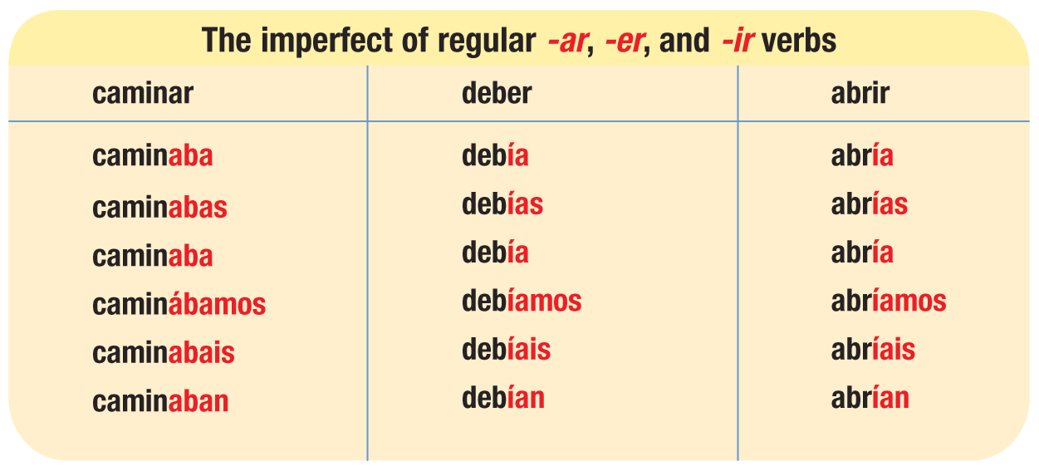
The imperfect tense of regular verbs is formed by dropping the infinitive ending (-ar, -er, -ir) and adding personal endings. -Ar verbs take the endings -aba, -abas, -aba, -ábamos, -abais, -aban. -Er and -ir verbs take -ía, -ías, -ía, -íamos, -íais, -ían.

Slide 3
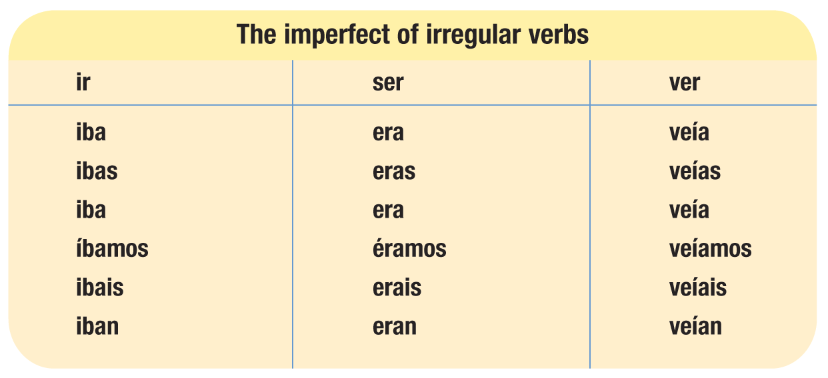
Ir, ser, and ver are the only verbs that are irregular in the imperfect.

Slide 4
The imperfect tense narrates what was going on at a certain time in the past. It often indicates what was happening in the background.
Cuando yo era joven, vivía en una ciudad muy grande. Todas las semanas, mis padres y yo visitábamos a mis abuelos.
When I was young, I lived in a big city. Every week, my parents and I visited my grandparents.

Slide 5
The imperfect of haber is había. There is no plural form.
Había tres cajeros en el supermercado.
There were three cashiers in the supermarket.
Sólo había un mesero en el café.
There was only one waiter in the café.

Slide 6
These words and expressions, among others, are often used with the imperfect because they express habitual or repeated actions without reference to their beginning or end: de niño/a (as a child), todos los días (every day), mientras (while).
De niño, vivía en un suburbio de la Ciudad de México.
As a child, I lived in a suburb of Mexico City.
Todos los días visitaba a mis primos en un pueblo cercano.
Every day I visited my cousins in a nearby village.

