Slide 1
Comparisons of inequality
With adjectives, adverbs, nouns, and verbs, use these constructions to make comparisons of inequality (more than/less than).
Adjective
Noun
Sus creencias son menos liberales que las mías. | El presidente tenía menos poder que el ejército.
His beliefs are less liberal than mine. | The president had less power than the army.
Adverb
Verb
¡Llegaste más tarde que yo! | ¡Nos peleamos más que los niños!
You arrived later than I did! | We fight more than the kids do!

Slide 2
Before a number (or equivalent expression), more/less than is expressed with más/menos de.
Necesito un vuelo a Santiago, pero no puedo pagar más de quinientos dólares. | Será difícil, señor. Déjeme buscar y le aviso en menos de una hora.
I need a flight to Santiago, but I can’t pay more than five hundred dollars. | That will be difficult, sir. Let me look, and I’ll let you know in less than an hour.

Slide 3
Comparisons of equality
The following constructions are used to make comparisons of equality (as...as).
Adjective
Noun
El debate de anoche fue tan aburrido como el de la semana pasada. | La señora Pacheco habló con tanta convicción como el señor Quesada.
Last night’s debate was as boring as last week’s. | Ms. Pacheco spoke with as much conviction as Mr. Quesada.
Adverb
Verb
Nosotros discutimos tan intensamente como los candidatos. | Ambos candidatos son insoportables. Ella miente tanto como él.
We argued as intensely as the candidates. | Both candidates are unbearable. She lies as much as he does.

Slide 4
Tan and tanto can also be used for emphasis, rather than to compare.
tan so
tanto so much
tantos/as so many
¡Tus ideas son tan anticuadas!
Your ideas are so outdated!
¿Por qué te enojas tanto?
Why do you get so angry?
Lo hemos hablado tantas veces y nunca logro convencerte.
We’ve talked about it so many times, and I never manage to convince you.
¡ATENCIÓN!

Slide 5
Superlatives
Use this construction to form superlatives (superlativos). The noun is preceded by a definite article, and de is the equivalent of in, on, or of.
Ésta es la playa más bonita de la costa chilena.
This is the prettiest beach on the coast of Chile.
Es el hotel menos caro del pueblo.
It is the least expensive hotel in town.

Slide 6
Absolute superlatives
The suffix –ísimo/a is added to adjectives and adverbs to form the absolute superlative.
This form is the equivalent of extremely or very before an adjective or adverb in English.
malo ➙ malísimo
mucha ➙ muchísima
rápidos ➙ rapidísimos
fáciles ➙ facilísimas
Adjectives and adverbs with stems ending in c, g, or z change spelling to qu, gu, and c in the absolute superlative.
rico ➙ riquísimo
larga ➙ larguísima
feliz ➙ felicísimo
Adjectives that end in –n or –r form the absolute by adding –císimo/a.
joven ➙ jovencísimo
trabajador ➙ trabajadorcísimo
¡ATENCIÓN!

Slide 7
The noun may also be omitted from a superlative construction.
Me gustaría comer en el restaurante más elegante del barrio.
I would like to eat at the most elegant restaurant in the neighborhood.
Las Dos Palmas es el más elegante de la ciudad.
Las Dos Palmas is the most elegant one in the city.

Slide 8
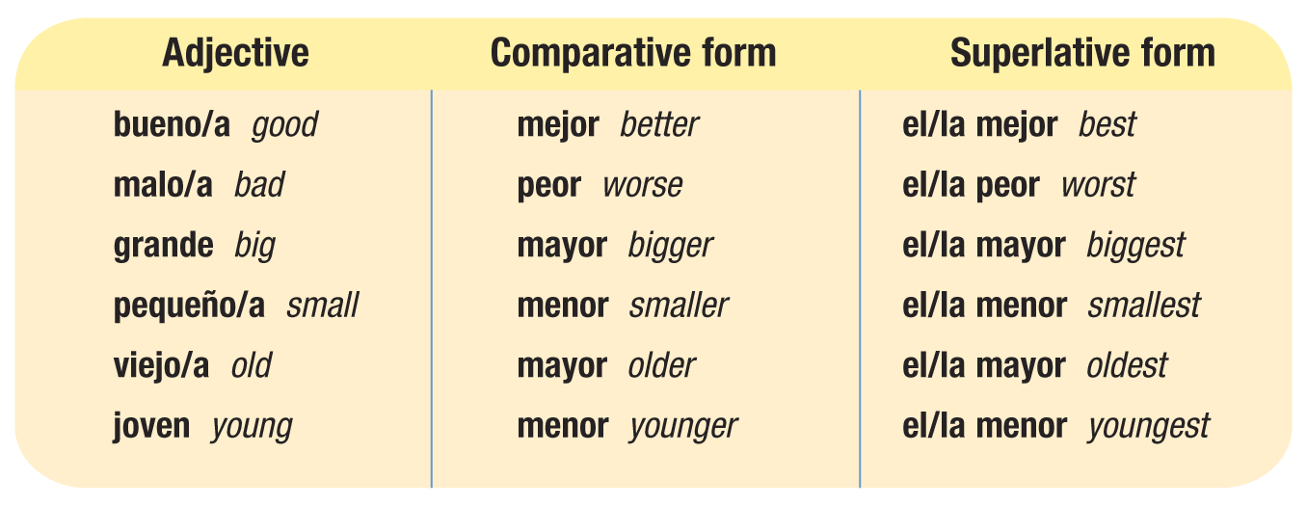
Irregular comparatives and superlatives

Slide 9
When grande and pequeño refer to size and not age or quality, the regular comparative and superlative forms are used.
Ernesto es más pequeño que yo. | Ese edificio es el más grande de todos.
Ernesto is smaller than I am. | That building is the biggest one of all.

Slide 10
When mayor and menor refer to age, they follow the noun they modify. When they refer to quality, they precede the noun.
Lucía es mi hermana menor. | La corrupción es el menor problema del candidato.
Lucía is my younger sister. | Corruption is the least of the candidate’s problems.

Slide 11
The adverbs bien and mal also have irregular comparatives.
Ayúdame, que tú lo haces mejor que yo.
Give me a hand; you do it better than I do.

